Slide 1
Automated Cyber Defense With Machine Learning
2d Lt James Marvin
Air Force Institute of Technology

Slide 2
Overview
What is Machine Learning (ML)?
Challenges to Implement Machine Learning
Wireless Sensor Networks (WSN)
ML + WNS: proof of concept
Splunk: a solution that could be implemented today
Giving Direction
Future work: Cyber Attack too?
References

Slide 3
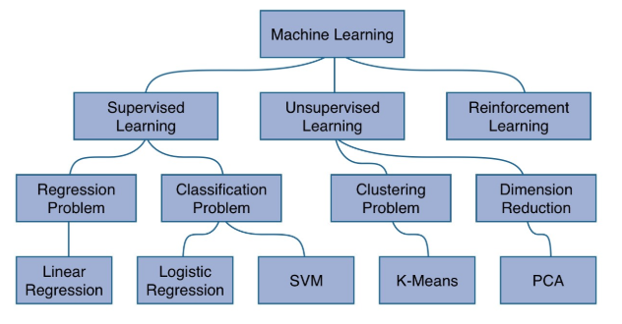
What is Machine Learning?
Methods that learn how to relate complex inputs to draw conclusions
The models learn by training on previously gathered data
Tested on new data
Verified by human interaction

Slide 4
Challenges to implement ML
Gathering the right data
[supporting evidence read off the script]
Knowledge of ML statistics
[supporting evidence read off script]
There are tools for each of the above problems
[indicate to audience that you will talk about this in a later slide]

Slide 5
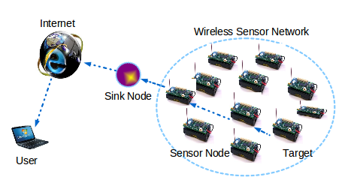
Wireless Sensor Networks
Network of small, inexpensive, and low power sensors
Nodes gather information about their environment
Forward sensed data to the sink node
Sink Node publishes the data to the user over internet connection

Slide 6

ML + WSNs: Proof of Concept
Case 1: Detecting selective forwarding attacks
[supporting details read off script]
Case 2: Outlier Detection
[supporting details read off script]
Case 3: General event detection
[Supporting details read off script]
All these activities have parallels in AF cyber domain
[parallels read from script]

Slide 7

Splunk: a solution that could be implemented today

Slide 8
Giving Direction
The Air Force should try to replace as much human-in-the-loop cyber defense as possible
We could move these cyber defenders over to attack
Bring the lethality to the enemy for deterrence
Might not need as many people in the end

Slide 9

Future Work: Cyber Attack Too?
Capabilities are not there yet
Similar to Drone Swarms
Guided by an operator but multiple machines carrying out simultaneous attacks on an adversary
ML to search for the chinks in the armor
Beefed up scan of the enemy network

Slide 10
References
Alsheikh, M.A., Lin, S., Niyato, D. and Tan, H.P., 2014. Machine learning in wireless sensor networks: Algorithms, strategies, and applications. IEEE Communications Surveys & Tutorials, 16(4), pp.1996-2018.
Baştanlar, Y. and Özuysal, M., 2014. Introduction to machine learning. In miRNomics: MicroRNA Biology and Computational Analysis (pp. 105-128). Humana Press, Totowa, NJ.
Janakiram, D., Reddy, V. A., & Kumar, A. P. (2006, January). Outlier detection in wireless sensor networks using Bayesian belief networks. In Communication System Software and Middleware, 2006. Comsware 2006. First International Conference on (pp. 1-6). IEEE.
Bahrepour, M., Meratnia, N., Poel, M., Taghikhaki, Z., & Havinga, P. J. (2010, November). Distributed event detection in wireless sensor networks for disaster management. In Intelligent Networking and Collaborative Systems (INCOS), 2010 2nd International Conference on (pp. 507-512). IEEE.
Jiang, X., Taneja, J., Ortiz, J., Tavakoli, A., Dutta, P., Jeong, J., ... & Shenker, S. (2007). An architecture for energy management in wireless sensor networks. ACM SIGBED Review, 4(3), 31-36.
Kaplantzis, S., Shilton, A., Mani, N., & Sekercioglu, Y. A. (2007, December). Detecting selective forwarding attacks in wireless sensor networks using support vector machines. In Intelligent Sensors, Sensor Networks and Information, 2007. ISSNIP 2007. 3rd International Conference on (pp. 335-340). IEEE.

